Slide 1
Project: Carbon Emissions from Five Countries with the Largest Forest from 1990 to 2019

Slide 2


The Team
Wilhelmus Medhavi
Fairuz Nur Indah Putri
Forestry Engineering Graduated
Forestry Engineering Graduated

Slide 3
What is Carbon Emission ?
What is carbon emission and why is it bad ?
Carbon dioxide is a problem because it acts as a “greenhouse gas”. Due to its molecular structure, CO2 absorbs and emits infrared radiation, warming the earth’s surface and the lower levels of the atmosphere. Source: inspirecleanenergy
What causes carbon emission ?
Direct emissions are produced by burning fuel for power or heat, through chemical reactions, and from leaks from industrial processes or equipment

Slide 4
Problem Introduction
The impact of climate change has begun to be felt very quickly in recent years. The leading cause of climate change is global warming due to excessive greenhouse gas emissions.
Greenhouse gases occur naturally in the atmosphere, but with human activities, the amount of these gases increases.
Several types of gases, such as carbon dioxide, methane, and nitrous oxide, are one of the leading causes of global warming.
The development of science and technology has encouraged human activities in exploiting available natural resources such as forests. One example is the conversion of forest land into residential, industrial, food, and other sectors.
According to FAO (2020) :
“Since 1990, it is estimated that 420 million hectares of forest have been lost through conversion to other land uses, although deforestation has decreased over the past three decades. Between 2015 and 2020, the rate of deforestation was estimated at 10 million hectares per year, down from 16 million hectares per year in the 1990s. The area of primary forest worldwide has decreased by over 80 million hectares since 1990.”

Slide 5
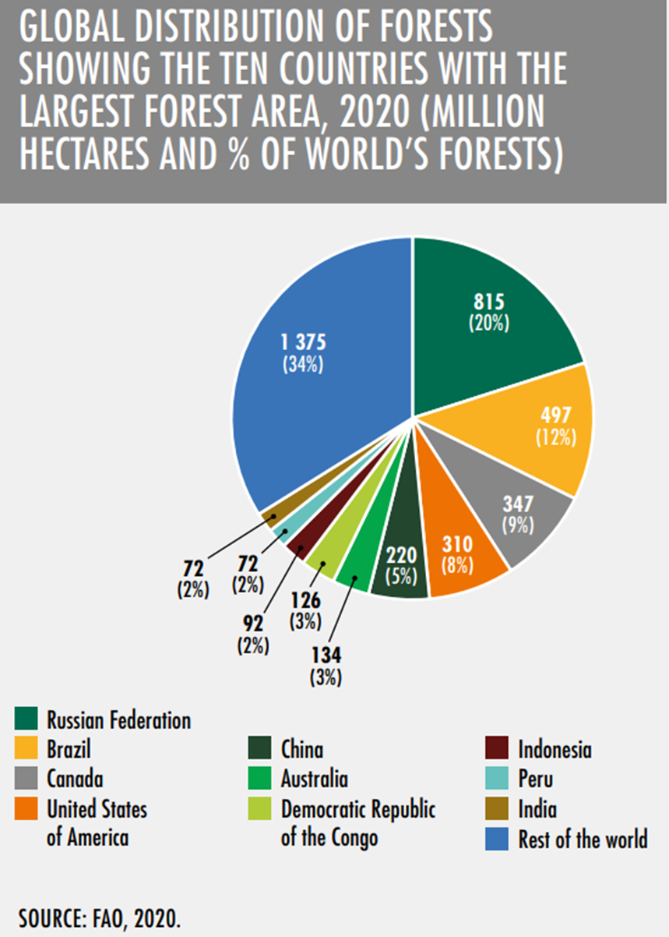
Problem Overview
The impact of climate change has begun to be felt very quickly in recent years, which is none other than the leading cause of global warming.
Global warming increases the earth's temperature by the emission of greenhouse gases, such as carbon dioxide, methane, and nitrous oxide.
It is necessary to record the footprint of greenhouse gas emissions (mainly carbon) in every country to reduce the level of greenhouse gas emissions

Slide 6
Goal and Objective
Goal
Objective
The main goal is to calculate the track record of the number of carbon emissions of each country, especially in countries with the potential to have high carbon emissions.
The objective is to visualise greenhouse gas emissions every year based on the track record of each country, along with the causes for carbon emissions (mainly from forest-related).

Slide 7
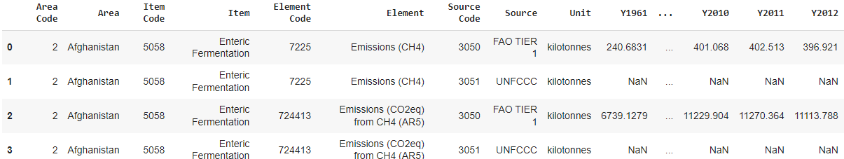
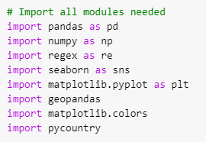
About Dataset
The data source : https://www.kaggle.com/datasets/ankitpranay/global-emissions-from-agriculture-and-forest-land
Module used in this project

Slide 8
About Dataset
There are 68 columns and 33434 column in the dataset, that is :
Area Code, Area, Item Code, Item, Element Code, Element, Source Code, Source, Unit, and years from Y1961 to Y2019.
Area: countries of the world Unit: Emissions from single gases (NH4, N2O,
Area Code: country code CO2) AND totals (CO2) in kilotonnes (kt)
Item: causes of carbon emission Y1961 - Y2019: time coverage
Item Code: code for each cause of carbon emission
Element: each type of element that causes carbon emissions
Source code: code for data source
Source: data source

Slide 9
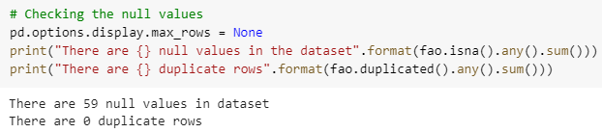
Checking the Duplicated and Null Values
There are 59 rows that have null values, that is years column from Y1961 to Y2019. Also, there are no duplicate column detected.

Slide 10
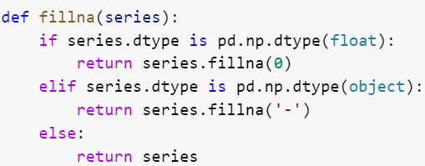
Data Cleaning
Handling Missing Value
Mostly the null value was detected in the year column from Y1961 to Y1990, maybe at that time there was no adequate technology to record carbon emissions on regular basis.
If the data type on specific column is object we fill the null values with “-” and if the data type is float we fill the null with 0

Slide 11

Data Cleaning
Change the Column Name
"Y" in "Y1961" indicates the year
Rename the column to contain only the year, remove the "Y" from the year column name. Also, we remove spaces with "_".

Slide 12
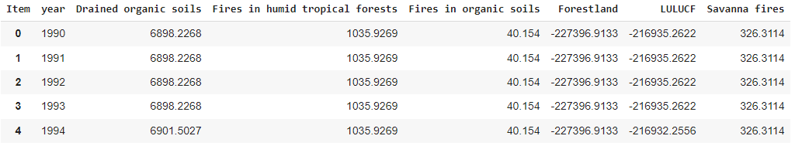
Selected Data
The country that we pick based on the country with the largest forest area, that is Brazil, Canada, Congo, Indonesia, and India.
We focus to analyze CO2(eq)(AR5) emitted by some event such as drained organic soils, fires in humid tropical forest, forest in organic soils, forestland, LULUCF, and savana fires. We analyze how much every causes of carbon emissions affected the amount of CO2(eq)(AR5) at some country.
Example dataset for Brazil

Slide 13
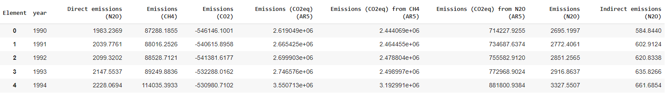
Selected Data
3. Additionally, we analyze all green house gasses that contain in dataset for every country
Example dataset for India

Slide 14
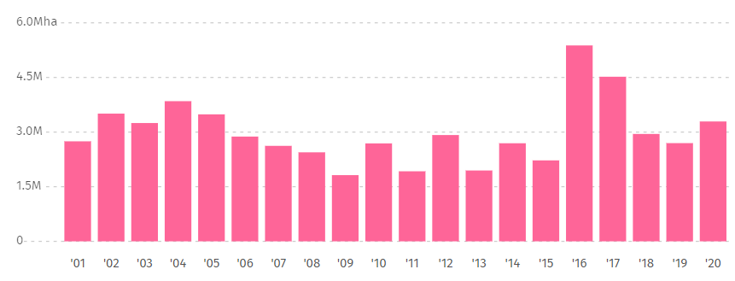
01
Brazil
The country with the second-largest forest area in the world.
According to Global Forest Watch :
In 2010, Brazil had 492 Mha of natural forest, extending over 59% of its land area.
In 2020, it lost 3.20Mha of natural forest, equivalent to 1.77 Gton of CO₂ emissions.
“From 2001 to 2020, Brazil lost 59.8Mha of tree cover, equivalent to a 12% decrease in tree cover since 2010, and 32.5Gt of CO₂ emissions.”
Source : Global Forest Watch

Slide 15
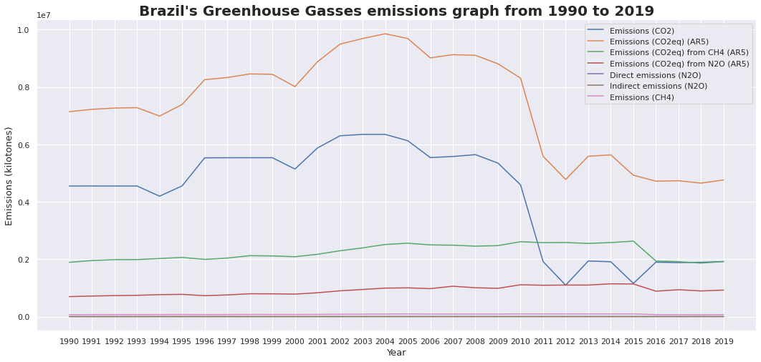
Brazil Analysis
Based on IPCC AR5, Brazil’s carbon emissions have increased from the early 1990s to their highest peak in 2004. In 2010 the graph began to experience a drastic decline until 2012, then there was a slight increase but fluctuated around 5 million kilotons (5 gigatons) until 2019. From 1990-2019, the total of Brazil’s carbon emission was around 137 Gigatonnes.

Slide 16
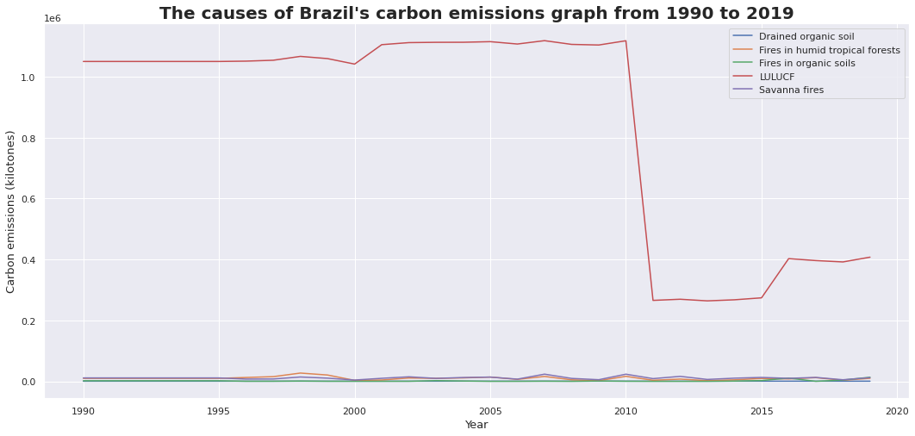
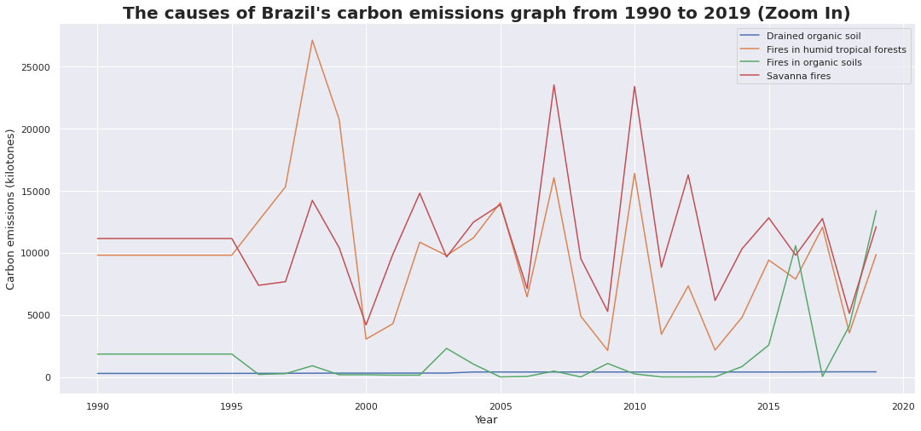
Based on the graph beside, the most significant cause of carbon emissions from Brazil is LULUCF (Land Use, Land Use Change and Forestry), exceeding 100 gigatonnes from 1990 to 2010. Brazil's LULUCF has decreased drastically to fluctuate at 300,000 kilotons (300 million tons).
Another cause of carbon emissions is tropical forest and savanna fires, which fluctuate between 5000 to 25000 kilotons of carbon.

Slide 17
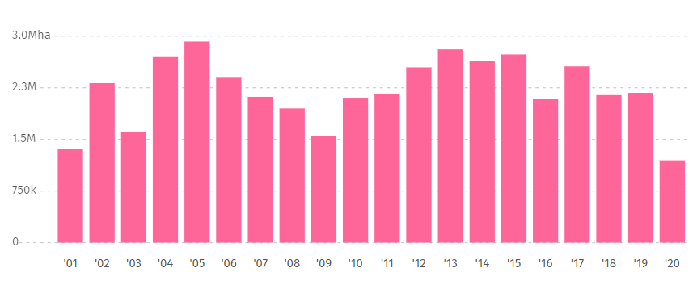
02
Canada
The country with the third-largest forest area in the world.
According to Global Forest Watch :
In 2010, Canada had 420Mha of tree cover, extending over 47% of its land area.
In 2020, Canada had lost 1.20Mha of tree cover.
“From 2001 to 2020, Canada lost 44.1Mha of tree cover, equivalent to a 11% decrease in tree cover since 2000.”
Source : Global Forest Watch

Slide 18
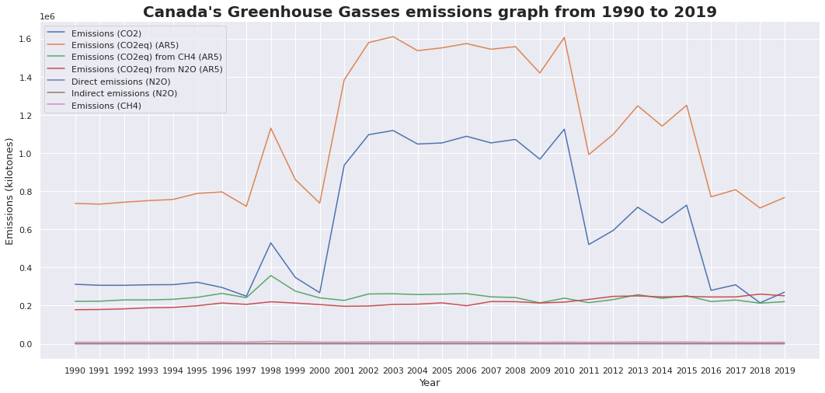
Canada Analysis
Based on IPCC AR5, Canada's carbon emissions have increased sharply from 1997-1998, then decreased again to below 800 Megatons in 2000. However, from 2001 to 2010 there was a significant increase in carbon emissions, reaching 1.6 Gigatonnes in 2003 and 2010. In the following years, Canada’s carbon emissions were still volatile in the following years until they finally stabilized back below 800 Megatons in 2016-2019. From 1990-2019, the total of Canada’s carbon emission was around 24 Gigatonnes.

Slide 19
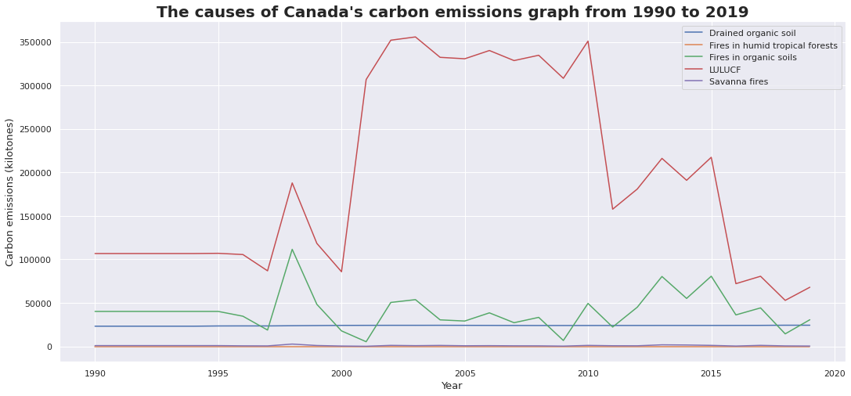
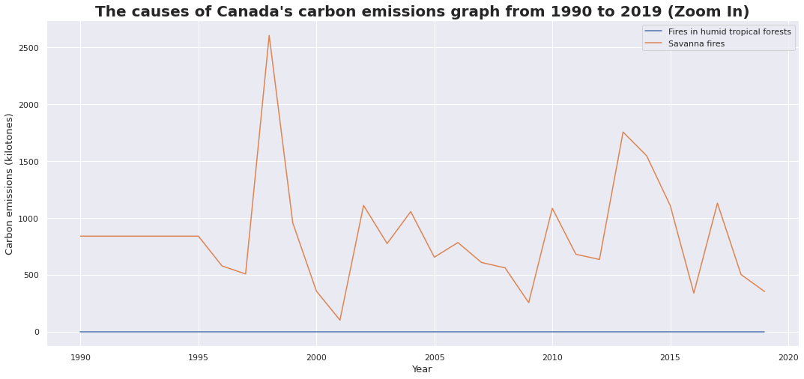
Based on the graph beside, the biggest cause of carbon emissions from Canada is LULUCF (Land Use, Land Use Change and Forestry) up to 350 Megatons. The LULUCF graph closely resemble the graphic form of Canada's carbon emissions based on IPCC AR5.
Another cause of carbon emissions is the drying and burning of organic soils. While the drying soil is steady at 25 Megatons, the burning soil fluctuates between 10-100 Megatons.

Slide 20
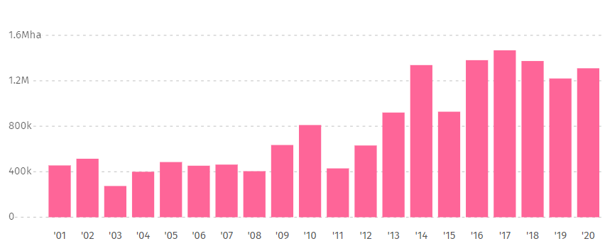
03
Congo
The country with the sixth-largest forest area in the world.
According to Global Forest Watch :
In 2010, Democratic Republic of the Congo had 198Mha of natural forest, extending over 85% of its land area.
In 2020, it lost 1.31Mha of natural forest, equivalent to 854Mt of CO₂ emissions.
“From 2001 to 2020, Democratic Republic of the Congo lost 15.9Mha of tree cover, equivalent to a 8.0% decrease in tree cover since 2000, and 9.71Gt of CO₂e emissions..”
Source : Global Forest Watch

Slide 21
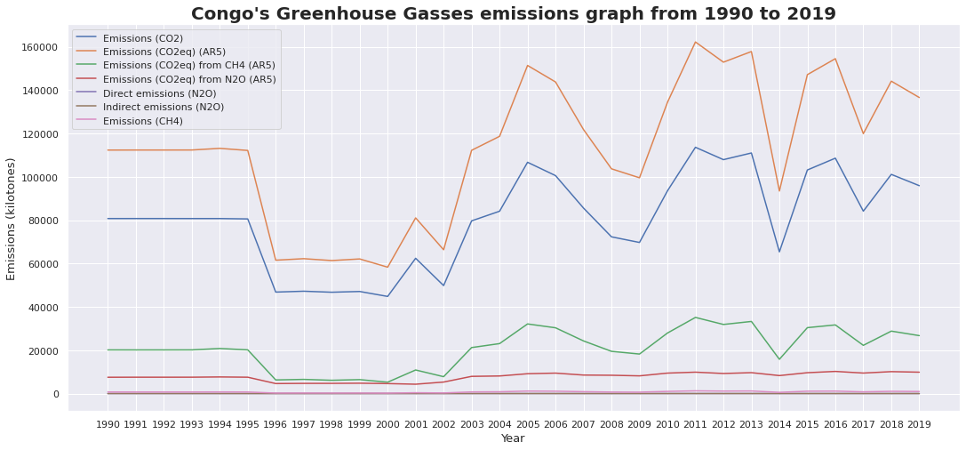
Congo Analysis
Based on IPCC AR5, Congo's carbon emissions in 1990-1995 were stable at around 115 Megatons, then dasecreed to almost 60 Megatons in 1996-2000. The Congo's emissions again increased from 2001 to 2019, with the highest peak passing 160 Megatons in 2011. From 1990-2019, the total of Congo’s carbon emission was around 2,4 Gigatonnes.

Slide 22
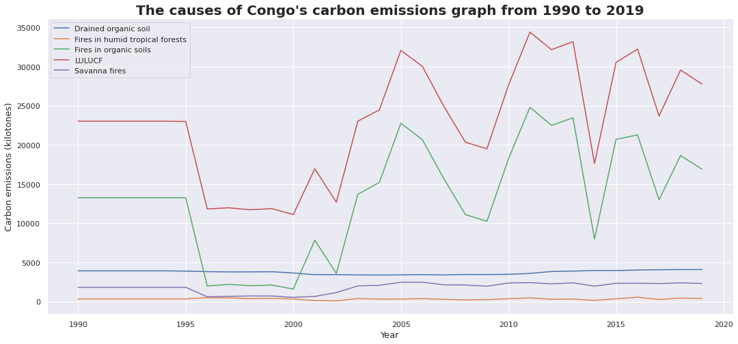
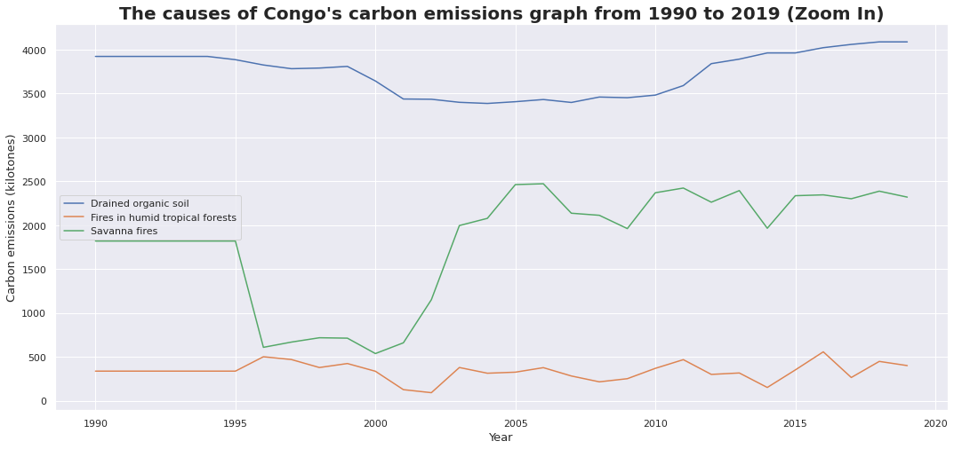
Based on the graph beside, the most significant cause of carbon emissions from Congo is LULUCF (Land Use, Land Use Change and Forestry) which reached almost 35 Megatons in 2011. The LULUCF and organic soil burning graph closely resemble the graphic form of Congo's carbon emissions based on IPCC AR5.
Other causes of carbon emissions are caused by drying of organic soil, tropical forest fires, and savanna fires with emissions below 5 Megatons, which tend to be smaller than other causes of emissions.

Slide 23
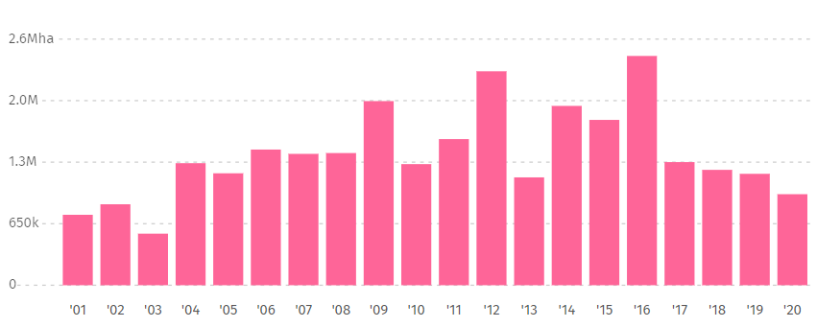
04
Indonesia
The country with the eighth-largest forest area in the world.
According to Global Forest Watch :
In 2001, Indonesia had 93.8 Mha of primary forest*, extending over 50% of its land area.
In 2020, it lost 270 kha of primary forest*, equivalent to 208Mt of CO₂ emissions.
“From 2001 to 2020, Indonesia lost 27.7 Mha of tree cover, equivalent to a 17% decrease in tree cover since 2000, and 19 Gt of CO₂e emissions..”
Source : Global Forest Watch

Slide 24
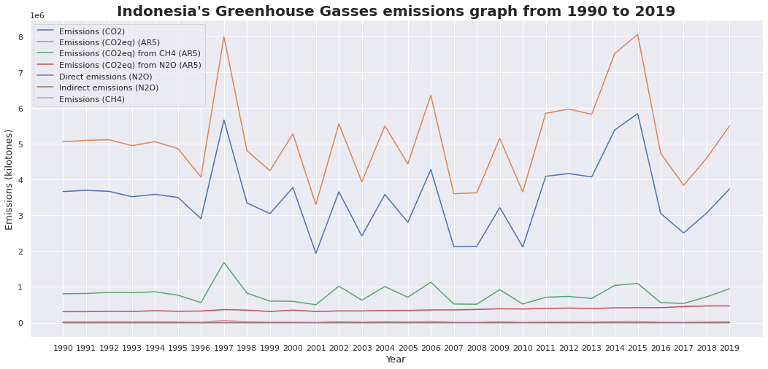
Indonesia Analysis
Based on IPCC AR5, Indonesia's carbon emissions fluctuate, which tends to have an increasing trend of around 3.5-8 Gigatonnes, with the highest peaks in 1997 and 2015. From 1990-2019, the total of Indonesia’s carbon emission was around 96 Gigatonnes.

Slide 25
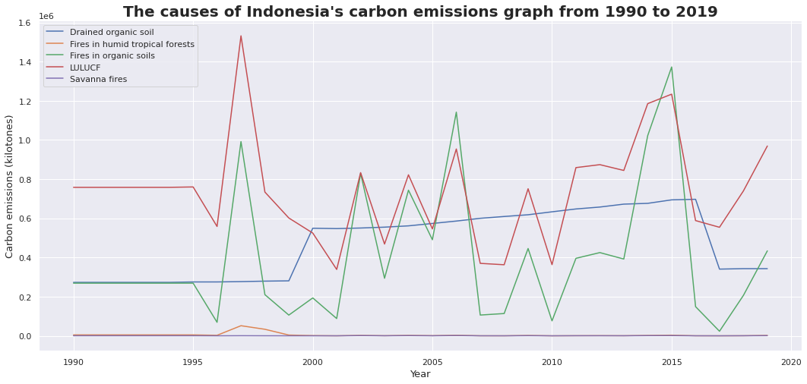
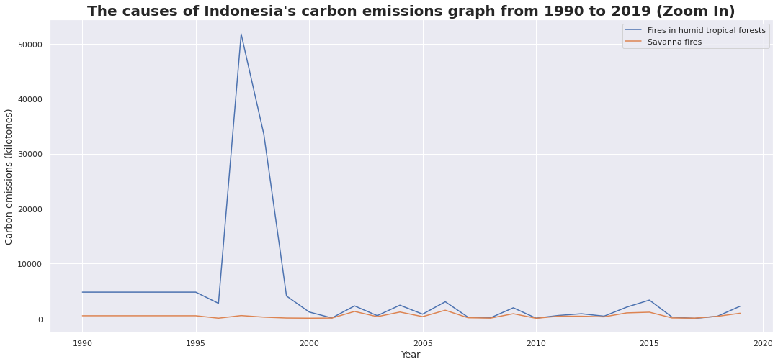
Based on the graph above, the most significant cause of carbon emissions from Indonesia is LULUCF (Land Use, Land Use Change and Forestry) which fluctuates around 800 Megatons, with the highest peak in 1997 of 1.6 Gigatonnes.
Other causes of carbon emissions are caused by the drying of organic soils with an increasing trend, and the burning of organic soils fluctuates. In 2006 and 2015, the burning of organic soil even exceeded the LULUCF of 1.2 and 1.4 Gigatonnes.

Slide 26
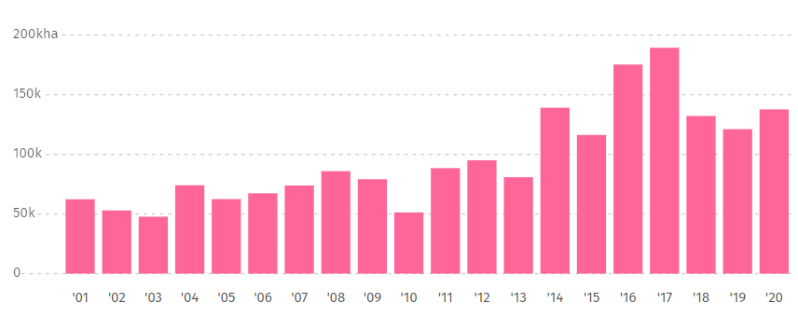
05
India
The country with the tenth-largest forest area in the world.
According to Global Forest Watch :
In 2010, India had 31.3Mha of natural forest, extending over 11% of its land area.
In 2020, it lost 132kha of natural forest, equivalent to 67.3Mt of CO₂ emissions.
“From 2001 to 2020, India lost 1.93Mha of tree cover, equivalent to a 5.0% decrease in tree cover since 2000, and 951Mt of CO₂e emissions.”
Source : Global Forest Watch

Slide 27
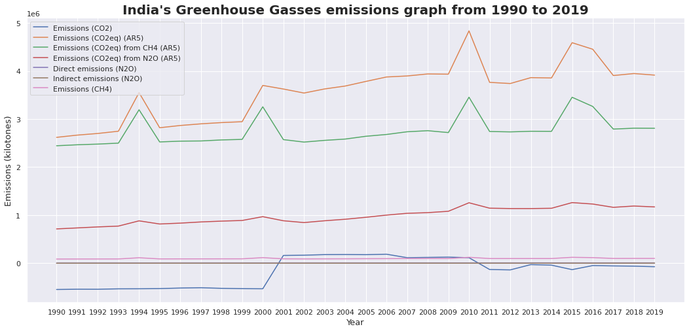
India Analysis
Based on IPCC According to IPCC AR5, India's carbon emissions tend to have an increasing trend, with several spikes in 1994, 2000, 2010, and 2015. Starting from 1990, India's total carbon emissions were around 2.5 Gigatonnes until in 2019 it has increased in about 4 Gigatonnes.. From 1990-2019, the total of India’s carbon emission was around 74 Gigatonnes.

Slide 28
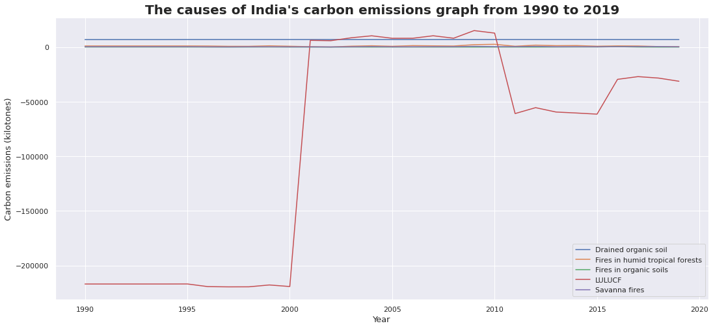
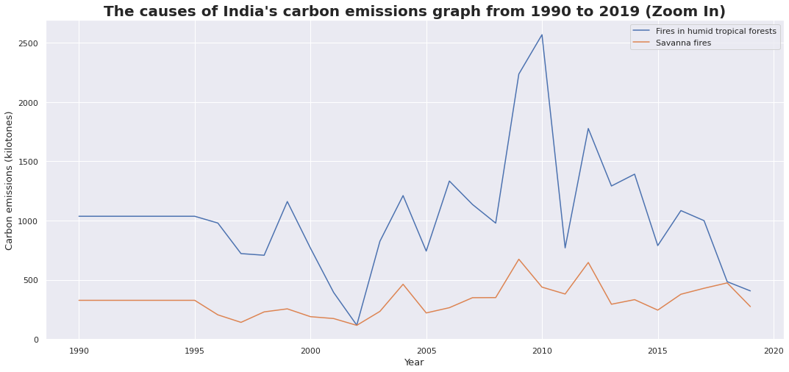
Based on the graph beside, the biggest cause of carbon emissions from India is LULUCF (Land Use, Land Use Change and Forestry) which has a minus value in 1990-2000 and 2011-2019, possibly caused by government programs to sequester carbon such as reforestation.
Another cause of carbon emissions is tropical forest and savanna fires, which have a fluctuating graph. Tropical forest fires fluctuate around 0.5 to 1.5 Megatons with a peak, and savanna fires fluctuate at 0.5 Megatons.

Slide 29
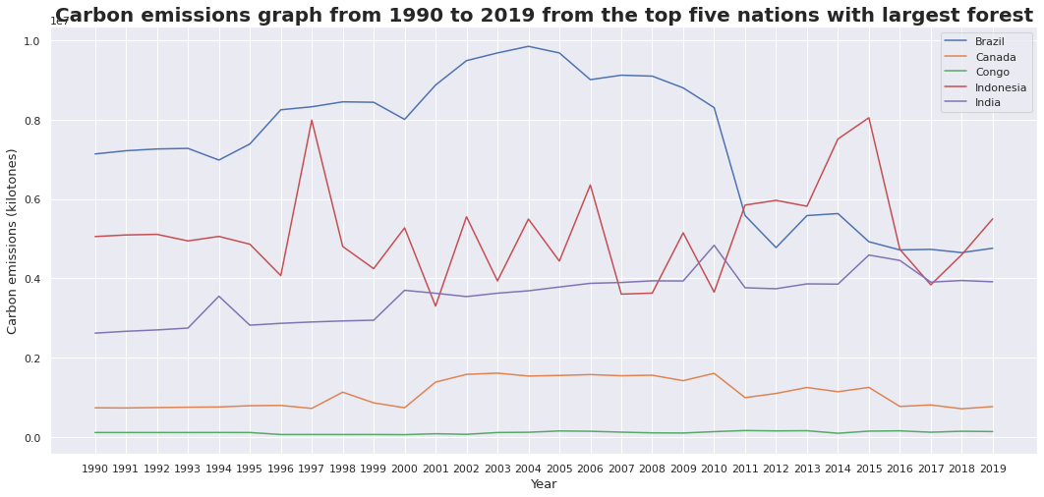
Graph of Comparison

Slide 30
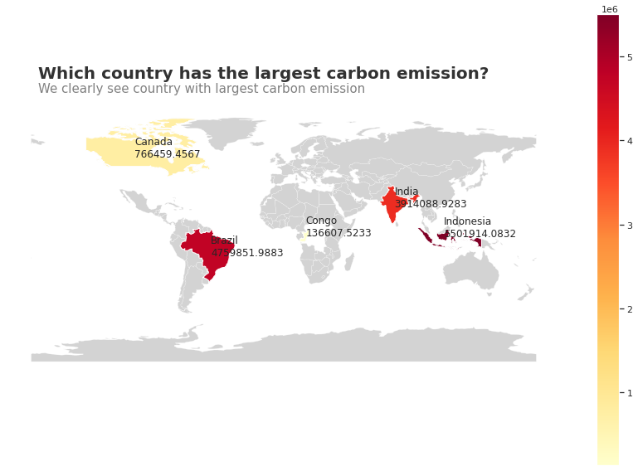
Carbon Emission in the Last 3 Years…
Based on the graphic map above, in 2019 Indonesia was the country with the highest amount of carbon emissions compared to the five countries analyzed previously.
Indonesia is a developing country with a tropical climate, which has the eighth largest forest area globally and is the fourth most populous country.
The increase in land-use change due to industrial development and settlement expansion can cause the country's high carbon emissions.

Slide 31
Conclusion
Carbon Emission
Based on the number of carbon emissions in 2019, Indonesia has the highest number of carbon emissions of 5.5 Gigatonnes, while Brazil has the highest number of carbon emissions based on the cumulative carbon emissions from 1990-2019 of 137 Gigatonnes.
The Causes for Carbon Emission
LULUCF mostly dominates the Causes of carbon emissions; These can occur due to increased human activities that require land-use changes. The amount of carbon emissions increases due to deforestation of forest land into built-up land, while reforestation can reduce emissions by trees absorbing carbon from the atmosphere.

Slide 32
Reference
FAO and UNEP. 2020. The State of the World’s Forests 2020. Forests, biodiversity and people. Rome. [https://doi.org/10.4060/ca8642en]
Global Forest Watch. 2022. Global Country Dashboard Map. Accessed Online at 13 April 2022 [https://www.globalforestwatch.org/]
Why are greenhouse gasses a problem? Accessed Online at 15 April 2022[https://www.inspirecleanenergy.com/]

